Slide 1
The Transformer Architecture
Study Notes

Slide 2
Lay Definition
In the context of machine learning, the Transformer architecture refers to an artificial neural network architecture that was invented to improve on previous architectures for language transduction.
It improved on competing architectures in terms of model simplicity, training time required and translation benchmark performance.
The key innovation was to do away with recurrent and convolutional layers and instead rely on a self-attention mechanism.

Slide 3
Uses
The primary use for which the Transformer was designed is machine translation.

Slide 4
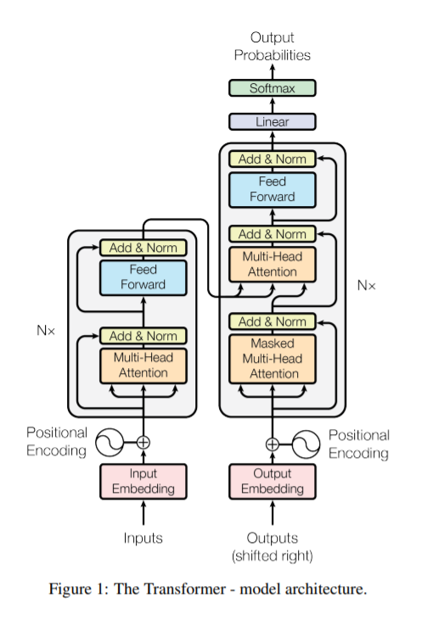
Technical Definition

Slide 5
History
The architecture was published in 2017
Vaswani, A., Shazeer, N., Parmar, N., Uszkoreit, J., Jones, L., Gomez, A. N., ... & Polosukhin, I. (2017). Attention is all you need. arXiv preprint arXiv:1706.03762.

